Slide 2
What is the focus of the website?
How technology affects the world
Catastrophes and law enforcement
New and evolving technologies
Political issues and the ways they are handled in different countries

Slide 3
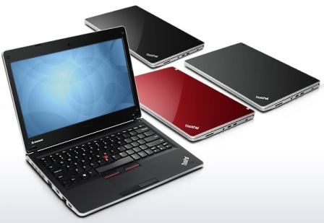
Hot Technologies and Related Issues
Lenovo ThinkPad Edge
Jason Cross, PCWorld

Slide 4
Lenovo ThinkPad Edge
New laptop created by PC maker Lenovo
More stylish yet compact version of original ThinkPad
Target market is small-medium size business class & business travelers
Features larger keys, longer battery life, ultra portable, faster system boot-up, $799 price

Slide 5
Hot Technologies and Related Issues
beezag
Robin Wauters, TechCrunch.com
Beezag…advertising. reinvented. period.

Slide 6
beezag
Created in 2009; “a real time targeted video advertising service”
Shows video ads to young adults (18-24) and solicits their feedback
Individuals selected on an “invite only” or waiting list basis
Ads sent based on profile and interests
Rewards received for viewing ad completely, including coupons, free apps, products, and even cash from the advertisers

Slide 7
beezag continued…
Company believes this age group has the time and financial need to view ads
Beezag claims this form of advertising is cost effective and 100% verifiable through questions at end of ad relating to floating numbers
Global company with clients such as Starbucks, Dentyne, & Dr. Pepper
Currently on Facebook & Twitter and has raised $2.5 million

Slide 8
What are the most important issues for business managers?
Information about competitors, business partners, suppliers, and customers
NY Times to charge for online content by 2011
Google’s 4th quarter profit nears $2.5 billion

Slide 9
Most Important Issues for Business Managers
New products, services, technologies
Google voice extension for chrome adds Click to Call
Lenovo ThinkPad Edge

Slide 10
Most Important Issues for Business Managers
Trends of business environment
Recorded 2009 music sales fell approximately 10%
Filmmakers eye Web, TV as alternate to theaters

Slide 11
Thank you!
Natallia Dziatsel
Susan Krause
Johnathan Whitaker
Matt Baker

